Slide 1
The Transcriptomic Signatures of Plant Memory
Austin Rosén
Colorado State University
Department of Biology

Slide 2
Introduction
I do not currently have RNA sequence data of my own
The solution: Use publicly available data!
What?: Perform RNA-seq analysis on raw data from a previous study, and attempt to achieve the same results
Why?: In order to gain proficiency in working with high-throughput sequence data
Prepare me for future data analysis
I have yet to work through an entire pipeline – raw data through data analysis
Great learning opportunity because can check/compare results
How?: Using the bioinformatics pipeline we were exposed to in DSCI512

Slide 3
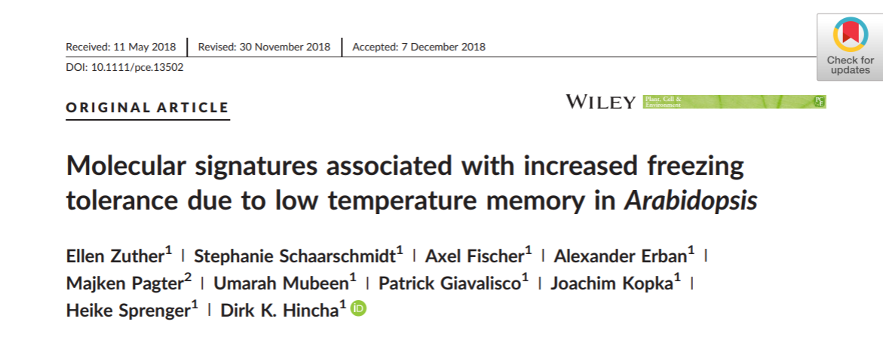
Study
Topic: The concept of plant memory associated with stress, and the corresponding molecular signatures

Slide 4
Background
Exposure to stress can bolster a plant’s defense response to a subsequent environmental stress, known as defense priming
Primed plants…
Require lower levels of stimuli to induce a defense response
Are more vigorous in their defense responses
In the context of temperature, cold exposure causes a plant to temporarily acclimate to the cold
Increased freezing tolerance
This stress also primes the plant to respond more effectively to a second cold exposure

Slide 5



Background
Conditions return to normal after a priming event
Plant slowly reacclimates
Known as lag or memory phase
At end of the memory phase, plants no longer acclimated
BUT, still illicit a stronger response to stress event (primed)
Lag or memory phase
Growth under normal conditions
Growth under normal conditions
No longer acclimated
Priming event

Slide 6
Plant Memory
In order to remain primed after a lag phase, a plant must have some sort of “memory” of the initial priming event
This “memory” allows a plant to respond to future stresses without requiring constitutive expression of genes involved in stress tolerance
In theory, plants would want to take advantage of warm Spring conditions by allocating resources to growth and development, while still being prepared for a frost event

Slide 7
Study Design
Plants were subjected to an initial priming event, a lag phase, and a subsequent triggering event
Memory genes could b those expressed after triggering but not after priming
28 Days
7 Days
20° C
20° C
Growth phase
Lag/memory phase
4° C
4° C
Priming phase
(3 Days)
Triggering phase
(3 Days)

Slide 8

Study Design
Samples taken for RNA-seq analysis
Freezing tolerance of the plant recorded (in LT₅₀)
LT₅₀ = temp. at which leaf experiences 50% ion leakage
28 Days
7 Days
20° C
20° C
Growth phase
Lag/memory phase
4° C
4° C
Priming phase
(3 Days)
Triggering phase
(3 Days)

Slide 9
The developmental control is used as a control to account for the extra 7-days of development between the priming and triggering phase
Are differences in response of primed plants vs. triggered plants simply due to difference in developmental stage?
28 Days
7 Days
20° C
4° C
20° C
4° C
Growth phase
Priming phase
(3 Days)
Triggering phase
(3 Days)
Lag/memory phase
Developmental Control
35 Days
20° C
4° C
Growth phase
Priming phase
(3 Days)

Slide 10
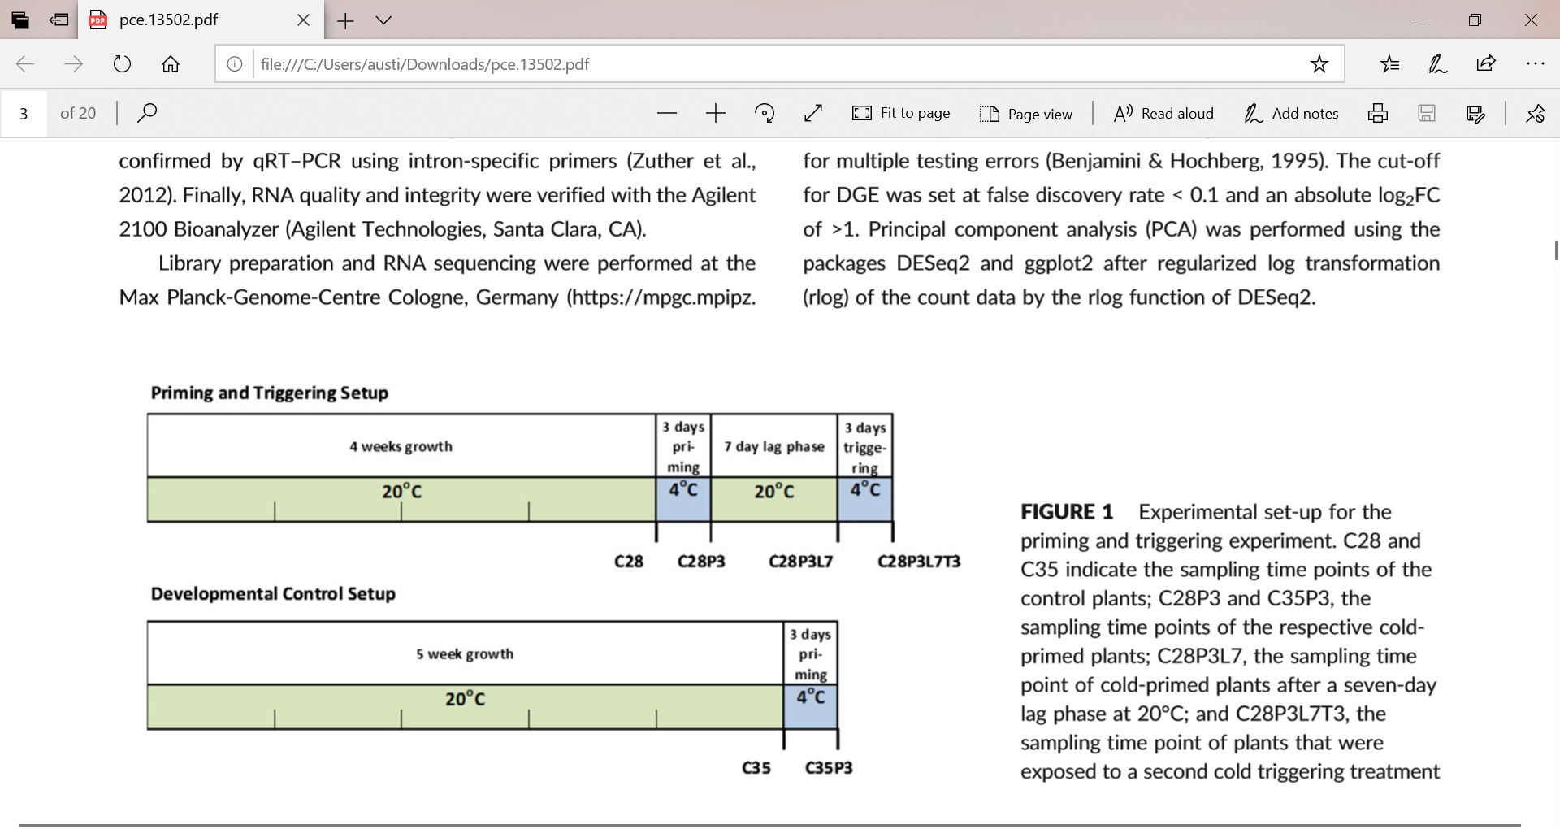
Study Design
Importance of the 7-day lag phase – reacclimation
A 3-day lag period was insufficient time for freezing tolerance to return to its original state (Zuther et al., 2015)
A 7-day lag period was sufficient for drought tolerance to return to control levels (Ding, Fromm, & Avramova, 2012)

Slide 11
Study Design
The experiment was originally performed for two A. thaliana varieties
6 measurements in each trial x 3 replicates x 2 Arabidopsis accessions = 36 samples
I decided to look at just one variety
Col-0 (intermediate frost tolerance) – 18 total samples
Col-0 (3 reps)
N14 (3 reps)

Slide 12
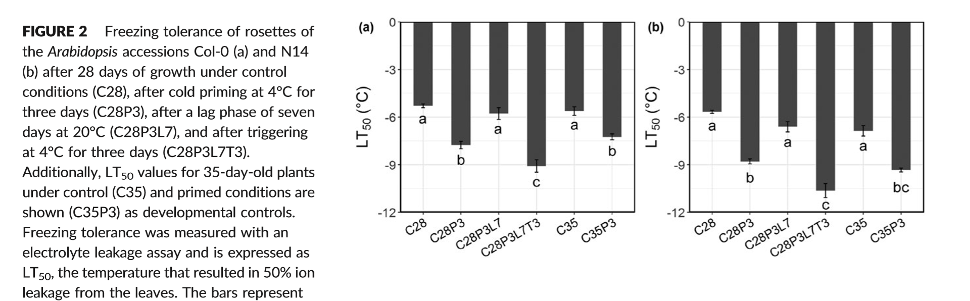
Results
As expected, primed plants had greater freezing tolerance than before being primed
After 7 days, freezing tolerance returned to values comparable to before the priming event
Plants subjected to a triggering event (2nd priming event) had even greater freezing tolerance than after a single priming event

Slide 13
Results
Why the higher freezing tolerance?
Perhaps the “memory” of a previous cold event further increased frost tolerance
Priming can further increase stress tolerance upon triggering even after lag phase
What does this look like on the molecular level?
Transcriptome, lipids, secondary metabolites
Same response as after the first priming event?

Slide 14
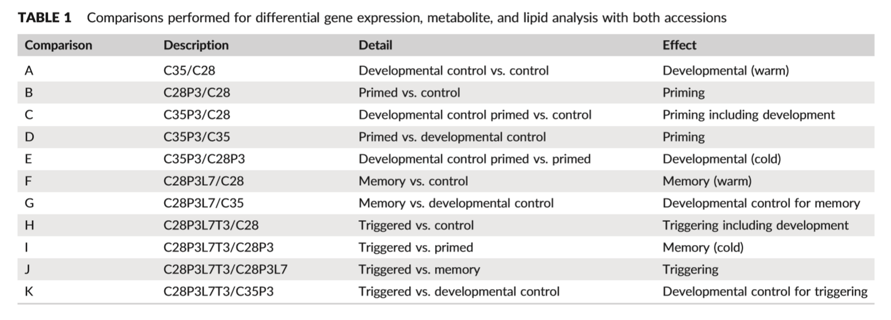
Results
For molecular data, a series of pairwise comparisons were made
They focused on contrasting Comparisons B, C, and H

Slide 15
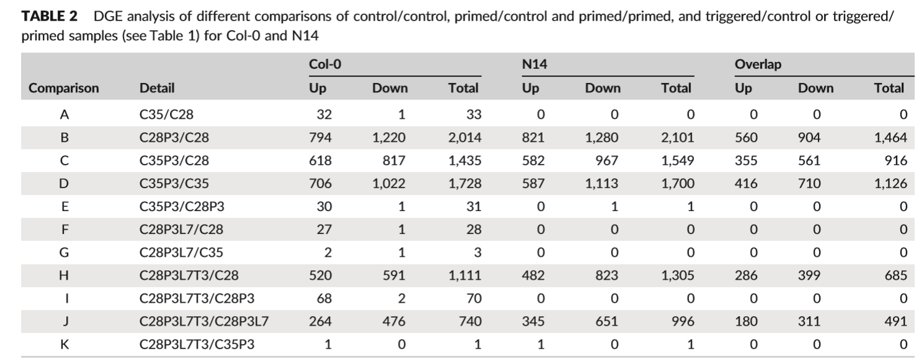
Results
Second triggering event
Overall weaker transcriptomic response
Several unique upregulated genes after triggering
Not upregulated after initial priming event – potential “memory” genes

Slide 16
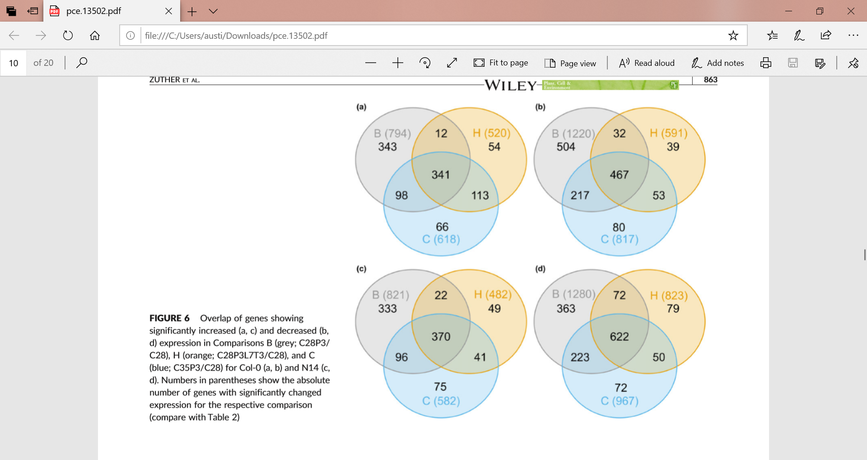
Results
Upregulated genes
Downregulated genes
Col-0
N14

Slide 17
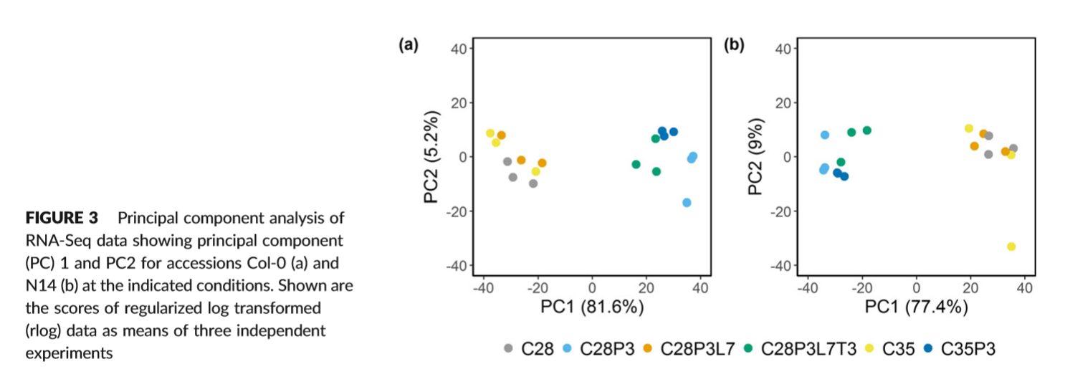
Results
Principle Components Analysis
Similar groupings in both accessions
Control samples grouping vs. primed/triggered samples grouping

Slide 18
Methods
Data acquisition
Samples taken from homogenized plant material
Total RNA isolated using TRIzol protocol
Libraries prepared with NEBNext Ultra Directional RNA Library Prep Kit for Illumina
Sequenced using Illumina HiSeq 3000
Generated 150 bp single-end reads
Raw reads deposited in the Gene Expression Omnibus (GEO) under accession number GES112225

Slide 19
Methods
Data analysis
Adapter trimming – flexbar version 2.5
All reads smaller than 80 bp were also removed
Read mapping performed against reference genome for Col-0
Genomic sequence, cDNA, and GTF annotation files downloaded from Ensembl Plants, Version TAIR10, release 31
Read mapping and tabulation performed using STAR software, version 2.5.2a
Parameters used in the study are also given
Differential Gene Expression (DGE) analysis was performed in R (version 3.4.2) using the package DESeq2
Principle Components Analysis (PCA) was performed using DESeq2 and ggplot2

Slide 20
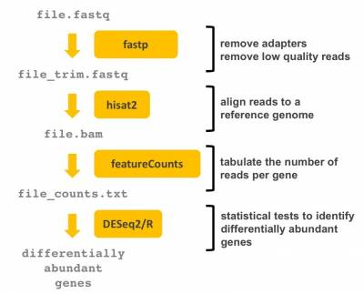
Pipeline comparisons
Zuther et al., 2018
Pipeline that I used
flexbar
STAR
STAR
DESeq2/R

Slide 21
Outcome
With slightly different bioinformatics pipeline, how will results change?
Ideally, the general results should be the same
No two software work exactly the same, but should see the same trends in the same data
DGE numbers should be similar, and we should see same clustering of samples in PCA
Where are the results different, if at all?
How are they different, and why?
If time, attempt functional enrichment analysis and compare to study

Slide 22
References
Ding, Y., Fromm, M., & Avramova, Z. (2012). Multiple exposures to drought ‘train’ transcriptional responses in Arabidopsis. Nature Communications, 3, 740.
Zuther, E., Juszczak, I., Lee, Y. P., Baier, M., & Hincha, D. K. (2015). Time‐dependent deacclimation after cold acclimation in Arabidopsis thaliana accessions. Scientific Reports, 5, 12199.
Zuther E, Schaarschmidt S, Fischer A, et al. (2019) Molecular signatures associated with increased freezing tolerance due to low temperature memory in Arabidopsis. Plant Cell Environ. 42:854–873.

